Slide 1
Kerberos
Understanding the Key Distribution Center Authentication Protocol

Slide 2
Introduction
Kerberos is a network authentication protocol designed to provide secure communication over unsecured networks. It uses tickets to allow nodes to prove their identity in a secure manner. This presentation explores its components and functionalities.

Slide 3
01
Introduction

Slide 4
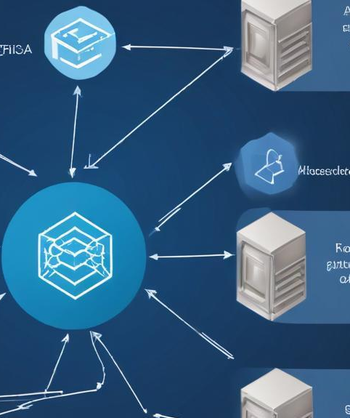
What is Kerberos?
Kerberos is a computer network authentication protocol developed at MIT. It aims to provide mutual authentication between clients and services using secret-key cryptography. The protocol ensures that communications are secure and encrypted, allowing users to authenticate to services without sending passwords over the network.

Slide 5
Applications of Kerberos
Kerberos finds extensive applications across various platforms and services. It is widely used in enterprise systems for centralized authentication, allowing users to access multiple services without repeated logins. Popular applications include Microsoft Active Directory, which employs Kerberos for secure logins, as well as cloud services that require secure access protocols. It also enhances security in web applications by ensuring secure sessions over HTTPS, preventing eavesdropping and man-in-the-middle attacks.

Slide 6
02
Functionality

Slide 7
Authentication Process
The Kerberos authentication process involves several key steps: firstly, a client requests an authentication ticket from the Key Distribution Center (KDC). Secondly, the KDC verifies the client's identity and issues a ticket granting ticket (TGT). Finally, the client uses the TGT to request access to specific services, receiving a service ticket in return. This process ensures that credentials are never transmitted in plain text, enhancing security.

Slide 8
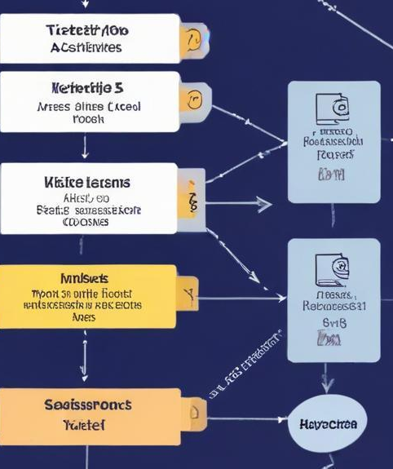
Tickets and Sessions
Kerberos relies on tickets for authentication and session management. When a user successfully authenticates, they receive a ticket granting ticket (TGT) valid for a specific time. This allows users to obtain service tickets as needed to access various network services without re-entering credentials. Each service ticket is encrypted and contains information about the user's identity and access permissions, which helps maintain the integrity and confidentiality of user sessions.

Slide 9

Conclusions
Kerberos remains a critical authentication protocol in today's digital landscape. Its robust security measures and efficiency in managing credentials have made it a preferred choice in various systems. Understanding Kerberos and its functionality is essential for organizations aiming to protect their networks from unauthorized access. As technology evolves, the principles of Kerberos will continue to underpin secure authentication practices across multiple platforms.

Slide 10
Thank you!
Do you have any questions?
Please keep this slide for attribution

